Slide 1
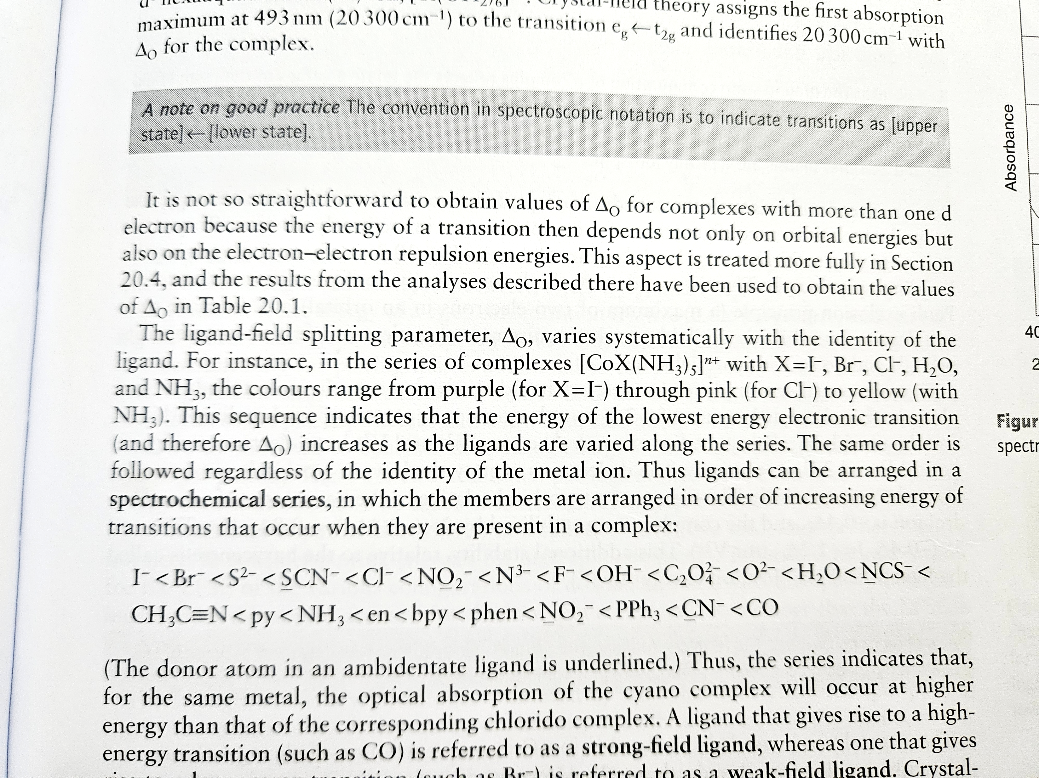
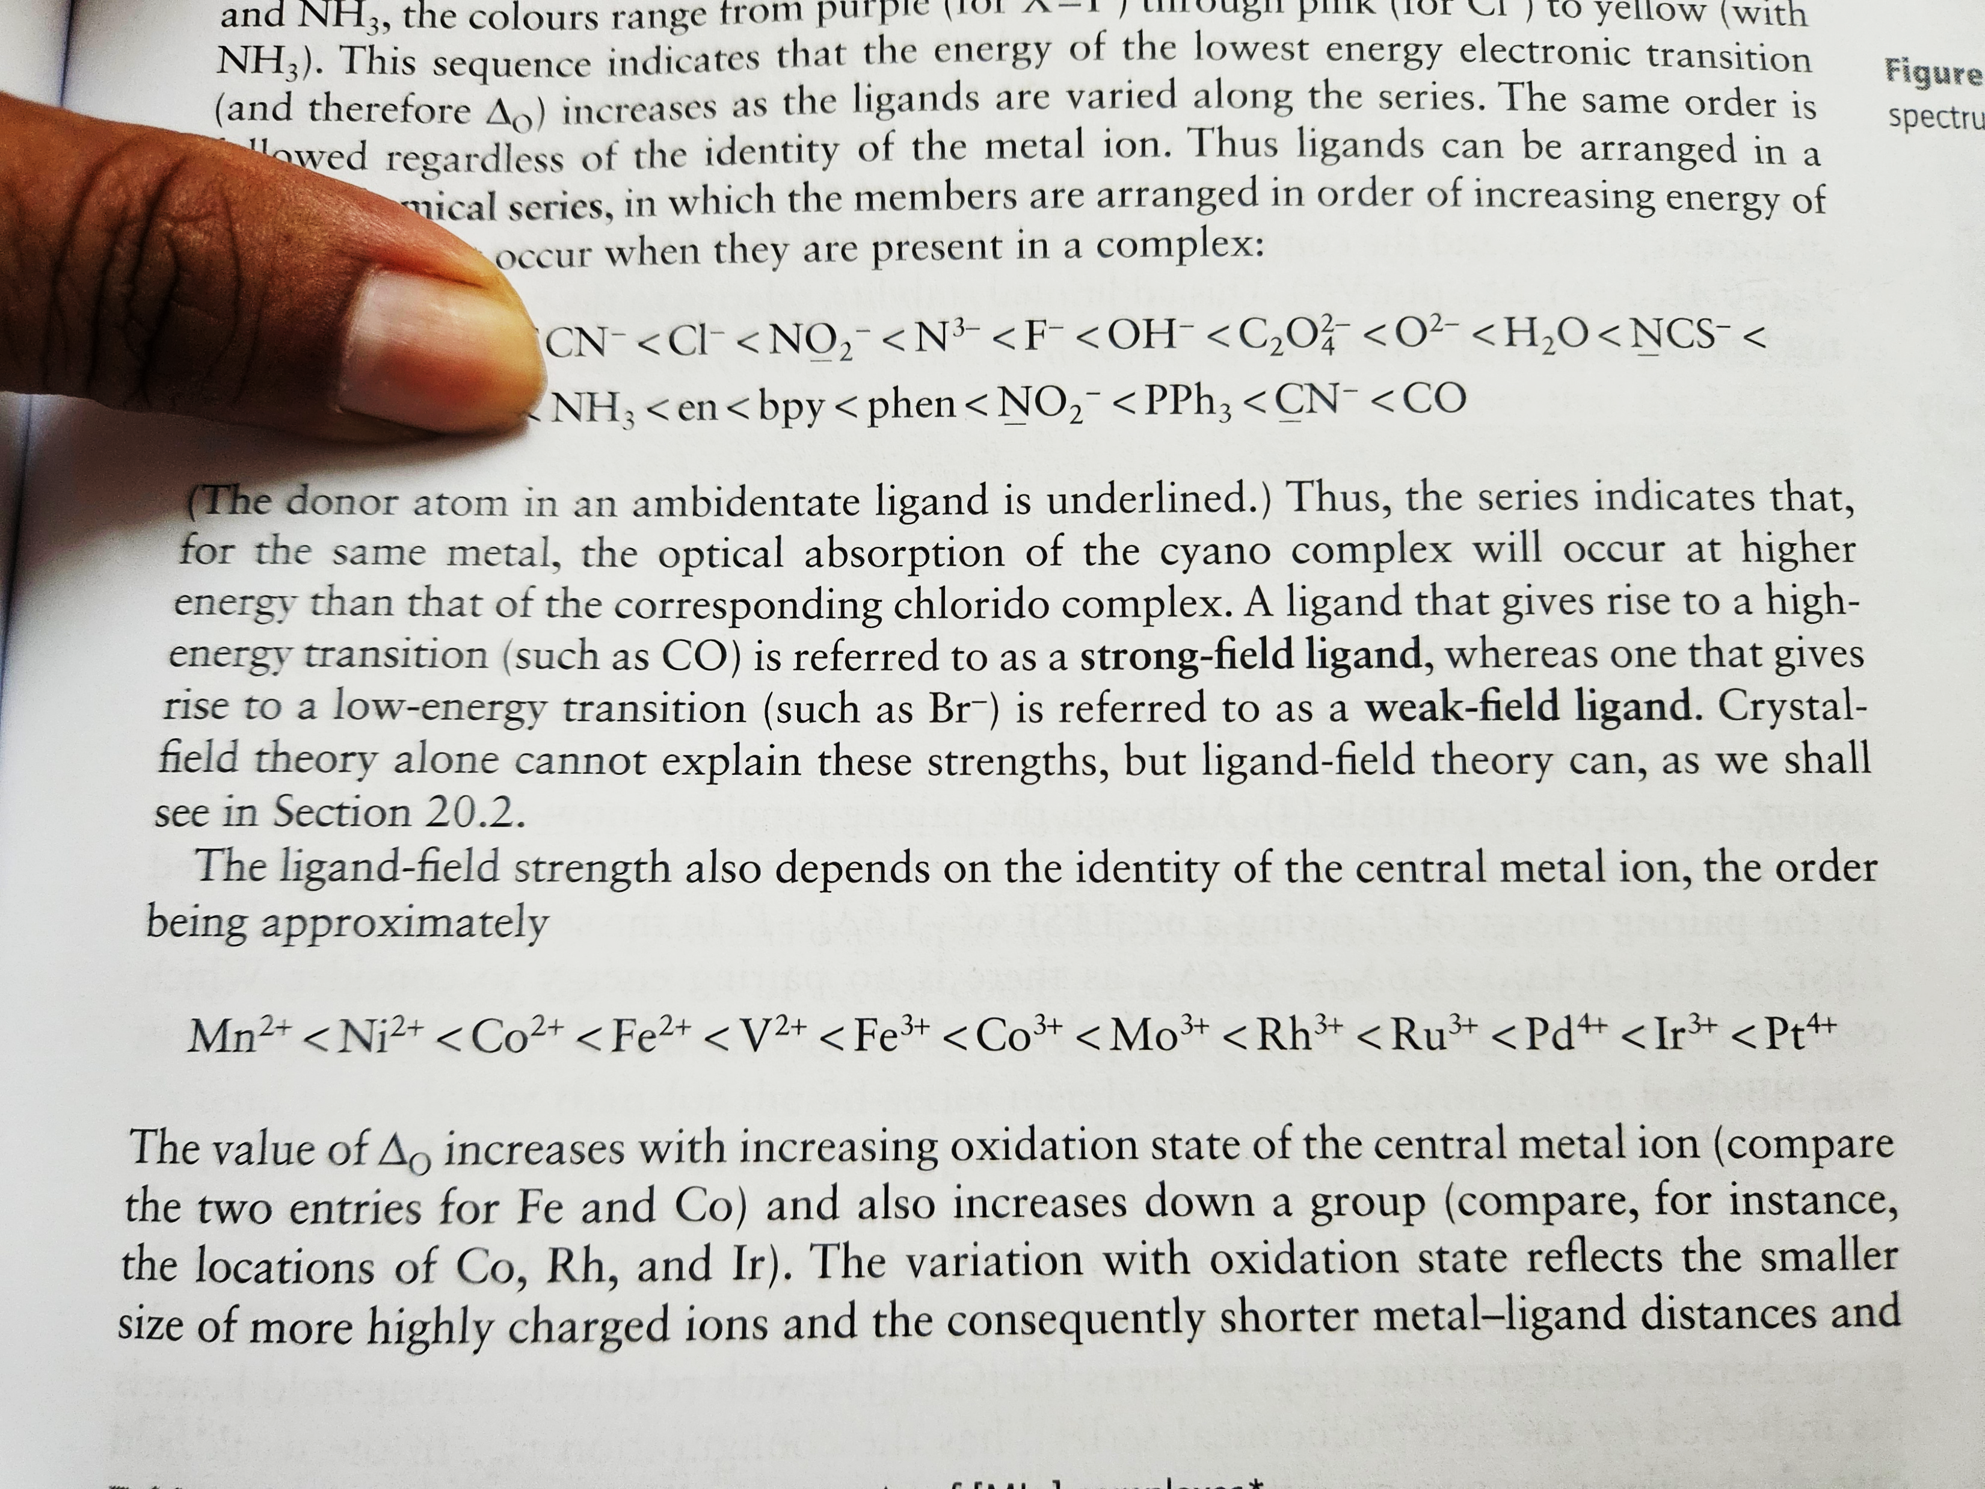
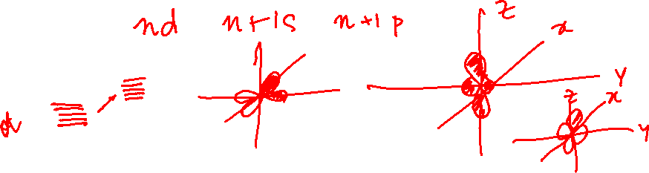
Crystal Field Theory
Spectroelectrochemical Series

Slide 2

















Slide 3
Simple symmetry concept

Slide 4






Slide 7
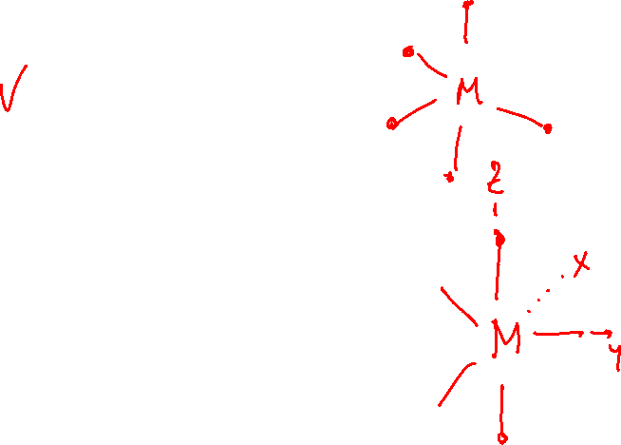

Slide 8





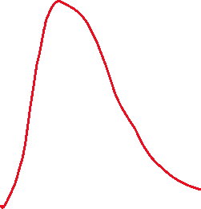







Slide 10
Molecular orbital theory: octahedral complexes
Shape of Ligand Orbitals

Slide 11
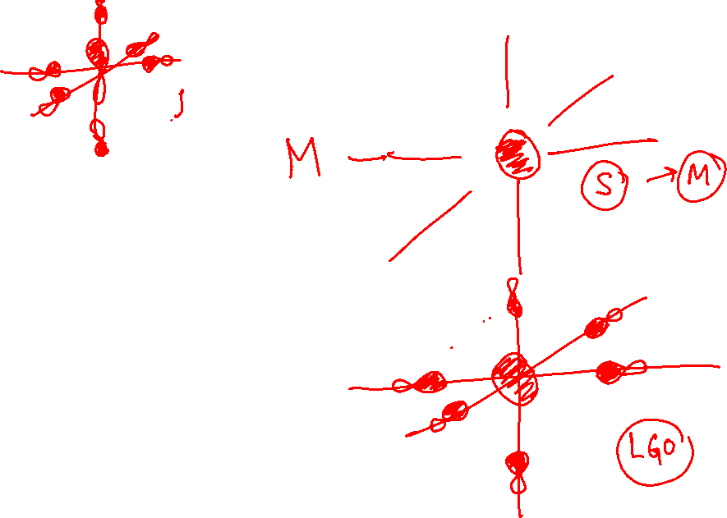

Slide 12
















Slide 13
Octahedral Complex
Tetrahedral Complex
Square-Planar Complex
Spectroelectrochemical series

